Slide 1

ECA4752 Principles Of Digital System Design For Memory
DESIGN AND IMPLEMENTATION OF AN AUTOMATIC SMART WASTE SEGREGATION DUSTBIN FOR WET AND DRY WASTE
Guided By :
Dr. M.Subalatha
Dr. Dinokuma
Presented By:
Chethrika Sri.K (192511112)
Kaviya. G (192524281)
Subhalakshmi (192524352)

Slide 2


INTRODUCTION
Waste generation has been increasing rapidly due to urbanization, population growth, and lifestyle changes.
Effective waste management begins with proper segregation of waste into categories such as wet (biodegradable) and dry (non-biodegradable).
In many places, segregation is still performed manually, which is inefficient, unhygienic, and prone to human error.
Lack of proper segregation leads to pollution, increased landfill waste, and difficulties in recycling processes.
To address these challenges, an automatic waste segregation system provides a smart, efficient, and user-friendly solution.

Slide 3
OBJECTIVE
To Create a Smart Dustbin that automatically senses and identifies incoming waste
To differentiate between wet and dry waste using sensor-based detection for improved accuracy
To automate the segregation Process using microcontroller-controlled mechanisms
To reduce human involvement handling, promoting hygiene and safety
To support recycling and sustainability by ensuring proper waste categorization at the source.

Slide 4
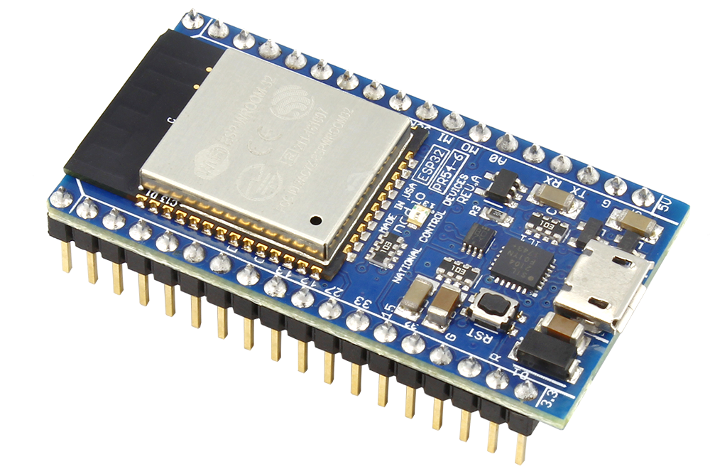
LITERATURE SURVERY
Studies show that most people do not separate waste, which makes recycling difficult and increases pollution.
Researchers used sensors like moisture sensors in earlier systems to detect wet waste automatically.
Many projects used microcontrollers (like ESP-32) to control motors and separate waste into different bins.
Previous models proved that automatic segregation reduces manual handling, improving cleanliness and safety.

Slide 5
PROBLEM STATEMENT
People throw dry and wet waste together without any separation.
Mixed waste becomes difficult to recycle and increases pollution.
Manual segregation is unhygienic and risky for waste workers.
Normal dustbins cannot identify whether the waste is dry or wet.
There is a need for an automatic system that separates waste at the source.

Slide 6
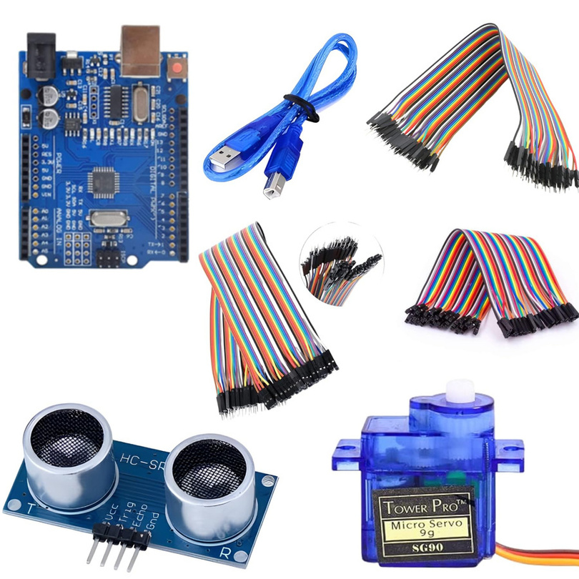
Components Required
ESP –32
Soil Moisture Sensor
Ultrasonic Sensor
Servo Motor
Jumper Wires
Breadboard
USB Cable

Slide 7
BLOCK DIAGRAM
IR sensor
.
Capacitive sensor
Waste
Ultrasonic
sensor
Separate bins
WET/DRY
Servo motor
ESP-32

Slide 8
Working Principle (Step-by-Step)
Step 1: Waste is placed in the bin and detected by the ultrasonic sensor.
Step 2: Detection triggers the ESP-32 to activate the system.
Step 3: The moisture sensor checks whether the waste is wet or dry.
Step4: ESP-32 decides the correct compartment based on sensor data.
Step 5: The servo motor rotates the flap/lid to guide waste into the appropriate section.
Step 6: System resets, ready for the next waste input.

Slide 9
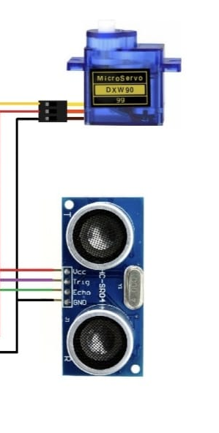
Module 1: Waste Detection Module
Uses sensors (moisture/IR/ultrasonic) to identify dry and wet waste.
Detects the type of waste as soon as it is placed near the dustbin.
Sends the sensor readings to the microcontroller for processing.
Ensures quick and accurate identification of waste category.
Reduces human error in separating waste manually.

Slide 10
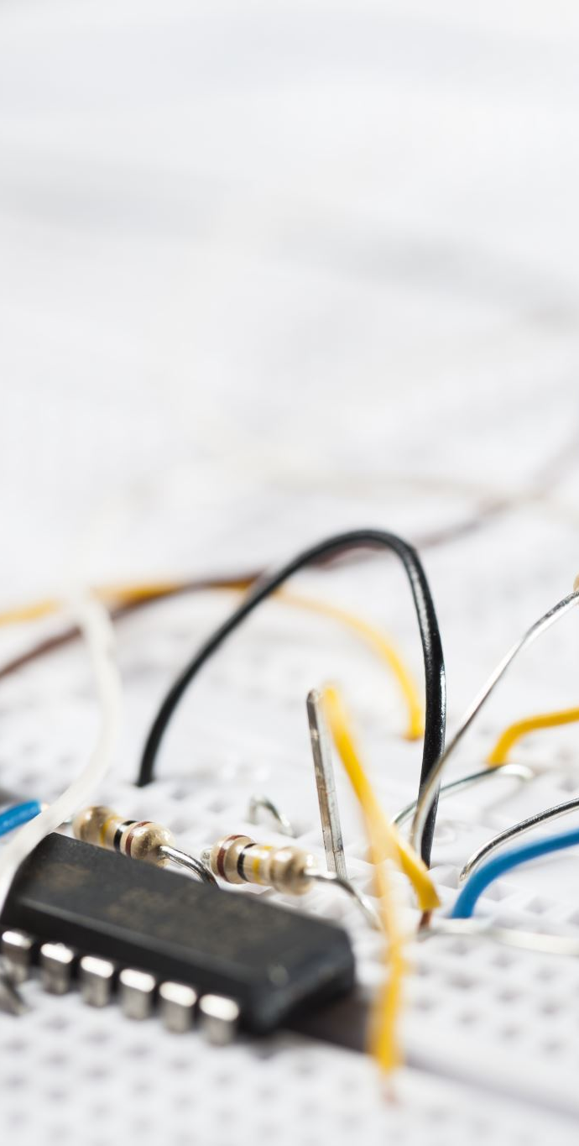
Module 2: Control & Processing Module
Arduino/microcontroller receives the signals from all sensors.
Processes the data to decide if the waste is dry or wet.
Controls the movement of the servo motor based on detection.
Ensures smooth coordination between sensors and mechanical parts.
Maintains accuracy and reliability of the whole system.

Slide 11
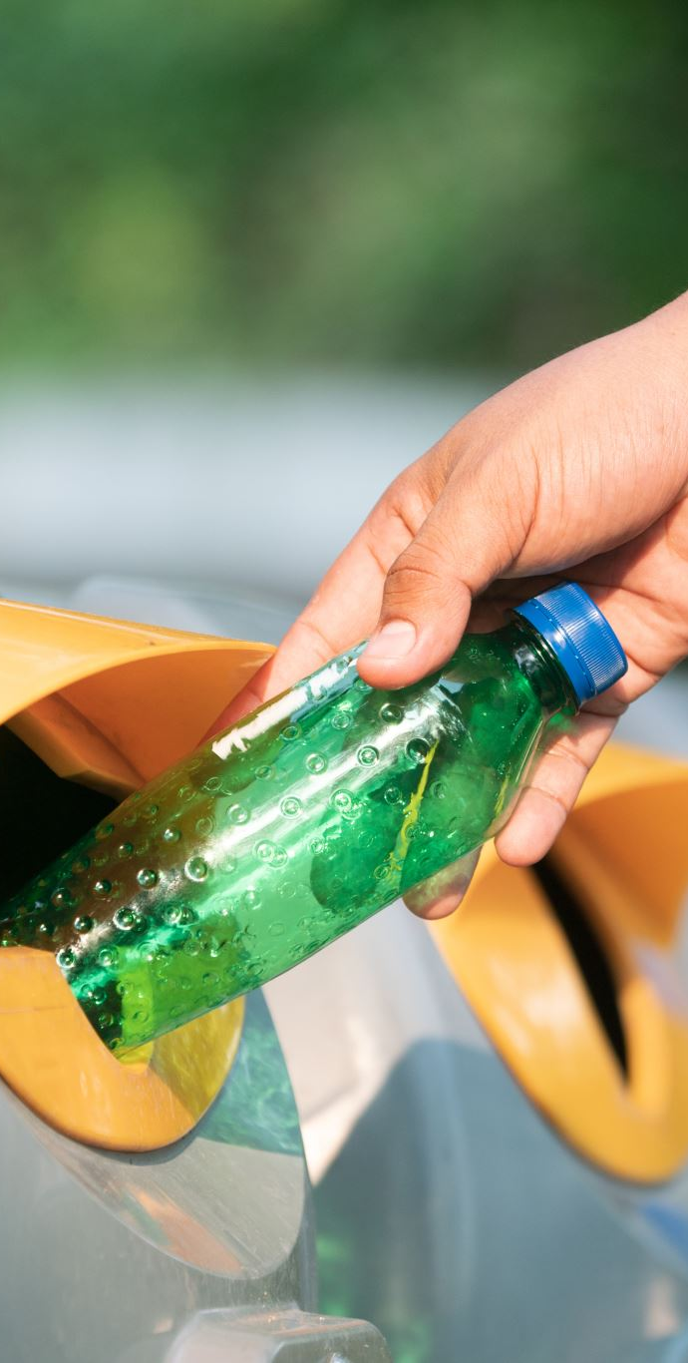
Module 3: Segregation & Storage Module
Servo motor directs the waste to the correct bin section.
Separate compartments are provided for dry and wet waste.
Ensures proper disposal without mixing the waste.
Helps in faster recycling and easy waste management.
Keeps the environment clean and reduces manual labour.

Slide 12
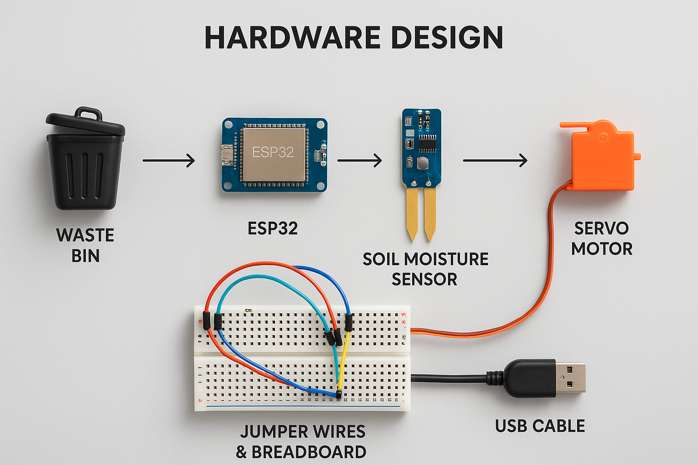
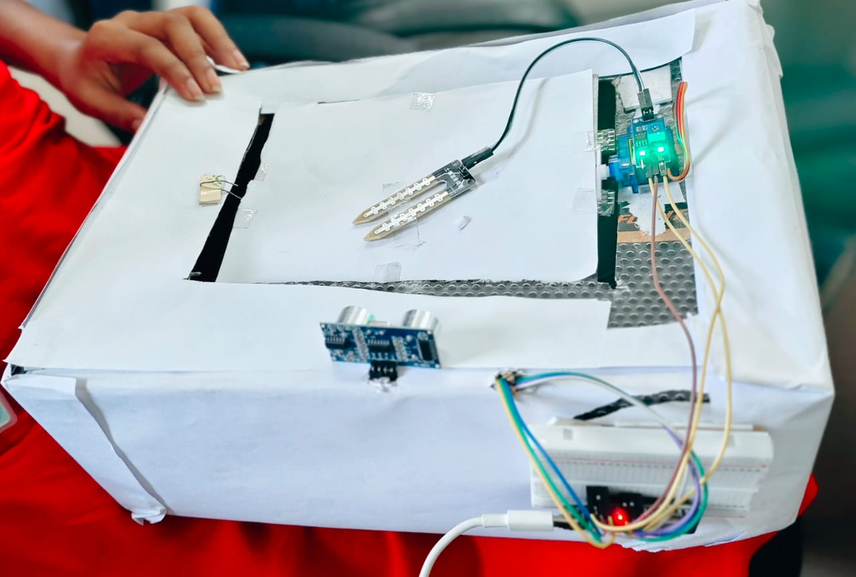
SYSTEM DESIGN

Slide 13
Advantages and Disadvantages
Works automatically
Keeps things clean and hygienic
Saves time and effort
Helps in recycling waste
Needs electricity to run
Costs more than a normal dustbin
Can wet and dry waste only separate

Slide 14
Applications
Schools, colleges, and offices
Smart cities and public places
Industrial waste management
Municipality waste management
Hospitals and healthcare facilities
Commercial spaces (malls, airports, railway stations)

Slide 15
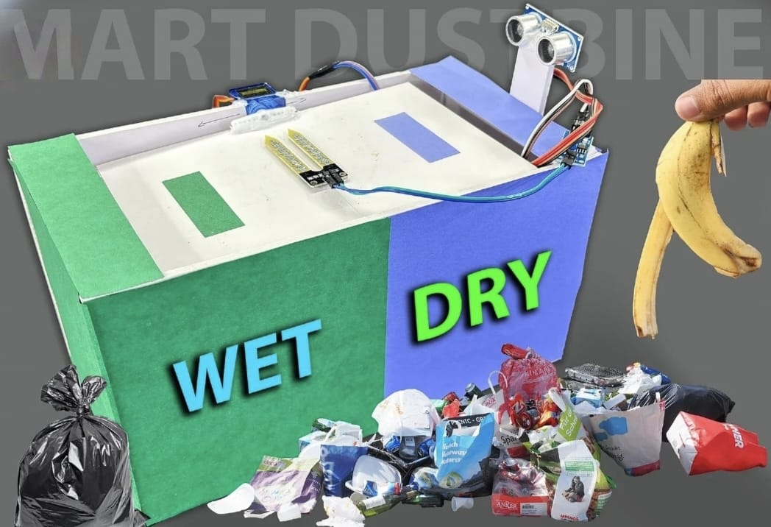
Conclusion
The smart bin easily separates wet and dry waste automatically.
Touch-free operation keeps the process clean and hygienic.
Sensors and a servo motor guide the waste to the correct side.
The system supports recycling and reduces pollution.
It is simple to use and useful in homes, schools, and public places.

Slide 16
REFERENCES
IEEE Conference Paper Reference: R. Singh, A. Sharma, “IoT-Based Smart Waste Segregation System Using Sensors,” IEEE International Conference on Smart Environments, 2023.
Research Journal Paper Reference: S. Kumar, P. Verma, M. Jain, “Automatic Waste Sorting System for Smart Waste Management,” International Journal of Scientific Research in Engineering and Management, 2024.
Academic Book Reference: A. Gupta, Introduction to Microcontroller-Based Automation, Tech Books Publishing, 2022.
Hardware Datasheet Reference: Arduino Documentation, Arduino UNO R3 Microcontroller Board Technical Guide, 2024.
Government / Waste Management Guidelines: Government of India, Solid Waste Management Guidelines for Smart Cities, Ministry of Housing and Urban Affairs, 2023.

Slide 17
THANK YOU !!

